Slide 1


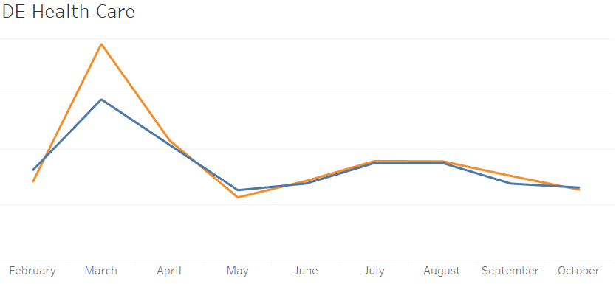
Companies
Job Seekers
SUPPLY
DEMAND
June
July
Supply
Demand
Rate of Unique JobID added
Rate of Unique JobID removed
Existing(carry-on)JobID rate.
--------- DEMAND RATE
----------- SUPPLY RATE

Slide 2
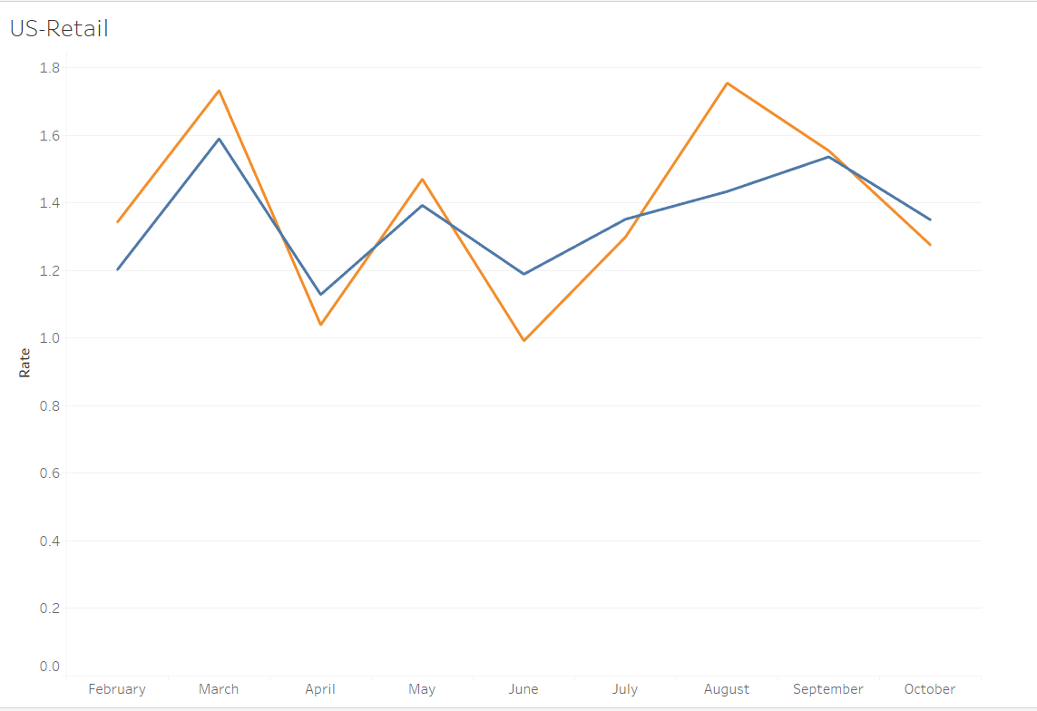
DEMAND RATE > SUPPLY RATE
Opportunity Assessment
Job Posting Cost increase per Job-ID – 117%*
Help recruiters optimize hiring
Right time
Save money
Hire the best talent
SUPPLY RATE > DEMAND RATE
Opportunity Assessment
Misses $100 per JobID
Recommend Companies to publish more job postings
--------- DEMAND RATE
----------- SUPPLY RATE
*
% change of{(Avg. cost/JobID(jul. to aug.) –Avg. cost/JobID(year))}

Slide 3
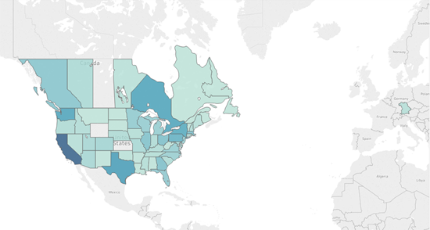
The Bigger Picture…
Model Scalability
Leverage Insight
Smart Recruiting Process
Win-Win for all Stakeholders
Notes:
•Serve as consultants, leverage insight reports to better understand the seasonal industry-wise hiring timeline
•Help company smarten the recruiting process to get them best talent before competitors.
•Capturing missed revenue by increasing marketing efforts and company tie-ups to increase supply
•Win-win situation for each stakeholder- Indeed.com, companies and job seekers.

